Slide 1
FLOWER CLASSIFICATION USING SVM AND SGD

Slide 2
GROUP MEMBERS
Bhargava Reddy Gangireddy - 700741262
Jahnavi Danda - 700674089
Rahul Lakum -700726522
Venkata Sowmya Tellapragada -700741741

Slide 3

Roles and responsibilities
Dataset collection: Rahul Lakum & Jahnavi Danda
Dataset loading and preprocessing coding: Bhargava Reddy & Rahul lakum
Algorithm implementation coding: Bhargava Reddy, Sowmya Tellapragada, Jahnavi Danda
Documentation: Sowmya Tellapragada

Slide 4
Motivation
There are approximately 250,000 named species of flowers worldwide, and there are many different types of flowers.
As this flower images have complex backgrounds, these tasks are time-consuming, and the accuracy of the results is still low, particularly when there are a large number of species to consider
There are many proposed models for the classification of flowers to get higher accuracy.
Our motivation is to create a flower classification system with at most accuracy & with less computational and time-consuming method.

Slide 5
Objective
We are going to classify the flowers using SVM and SGD
First, we used a classification model to improve the performance of flower image classification by using SVM for feature extraction followed by SGD algorithms for classification.
Second, we demonstrated how image augmentation can be used to improve the performance of a computer simulation.
Last but not least, we compared the performances of machine-learning classifiers such as support vector machines.

Slide 6
Related work
Nilsback et al pointed out that the most important factors to consider when categorizing flowers are colour and type unit of measurement. The flower is segmented using a threshold-based method, and texture options are extracted as a result. This includes the colour texture moments (CTMs), grey level co-occurrence matrix (GLCM), and scientist responses, unit of measurement.
A probabilistic neural network is used to apply the measures of choice for classification. Using principal component analysis, Y. Yoshioka et al. quantified the range of leaf colours. On the petals, they considered the first five principal components (PCs) of the largest square. T. Saitoh et al detailed an automated method for identifying a flower in bloom, which relied on a method for removing the flower's bottom parts.

Slide 7
Problem statement
Given that flower images have complex backgrounds, these tasks are time-consuming, and the accuracy of the results is still low, particularly when there are a large number of species to consider.
Using machine learning, researchers have recently demonstrated a number of successes in a variety of topics in the field of computer vision, including object detection, image segmentation, and image classification, among others. Our main motivation is to create a flower classification system with at most accuracy & with less computational and time-consuming method.

Slide 8
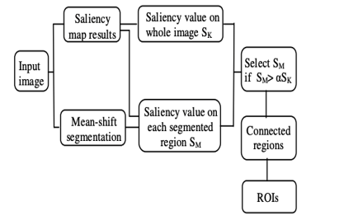
Proposed Solution
1)The images of flowers in this dataset is total 4242 images. The images are categorized into five categories: chamomile, tulip, rose, sunflower, and dandelion, among others.
2) Preprocessing data is one of the most crucial processes in the machine learning process.The floral areas of a photograph are typically overlaid on a complex background.To select the ROI (Region-Of-Interest) on flower images, we use saliency-segmentation-based approaches.
The proposed pre-processing to select the regions of interest (ROI) of flowers.

Slide 9
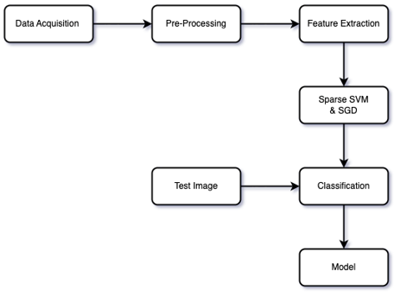
3)Next, Support vector machines with other penalties, such as the L1 penalty and the elastic net, for feature selection and prediction has been proposed to deal with the big omics data problem with a large number of features. These methods, on the other hand, are dealing directly with the primal variables
4)Finally, Stochastic Gradient Descent algorithm will try various coefficient values in search of a cheaper price, and then it will update the coefficient using a learning rate value to convert it on the following iteration.
WORKFLOW

Slide 10
Results
For the validation we are going to use the precision and the recall.
Precision=TP/(TP+FP),
Recall=TP/(TP+FN)
2) Scores of the SGD model are:
Accuracy score= 0.25
Recall score=0.25
Precision score= 0.33

Slide 11
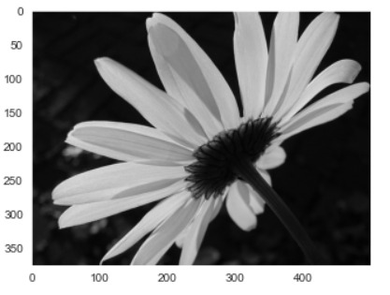
3) Scores of the SVM model are:
Accuracy score= 0.42
Recall score=0.42
Precision score= 0.50
Predicted flower is daisy according to SVM training results

Slide 12
References
Patel, Sanskruti & Patel, Isha. (2019). Flower Identification and Classification using Computer Vision and Machine Learning Techniques. International Journal of Engineering and Advanced Technology. 8. 277-285. 10.35940/ijeat.E7555.088619.
Jana Wäldchen, Michael Rzanny, Marco Seeland, Patrick Mäder, “Automated plant species identification—Trends and future directions”, Pols, Computational Biology, April 5, 2018.
Isha Patel, Sanskruti Patel, Atul Patel, “Analysis of Various Image Preprocessing Techniques for Denoising of Flower Images”, International Journal of Computer Sciences and Engineering, Vol.-6, Issue-5, May 2018, pp. 1012-1018.
Huthaifa Almogdady, Dr. Saher Manaseer, Dr.Hazem Hiary, “A Flower Recognition System Based On Image Processing and Neural Networks”, International Journal of Scientific & Technology Research Volume 7, Issue 11, November 2018.
Kukade, Manoj & Karve, Tanay & Gharpure, Damayanti. (2019). Identification and Classification of Spices by Machine Learning. 1-13. 10.1109/ICISGT44072.2019.00015.

Slide 13
THANK YOU

